Slide 1
Competitive Analysis
The Dream Team
Mask Dispenser
ME360

Slide 2
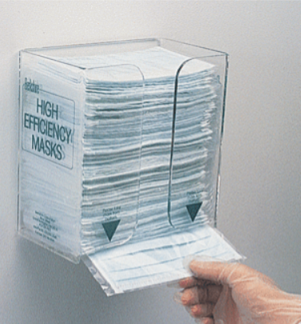
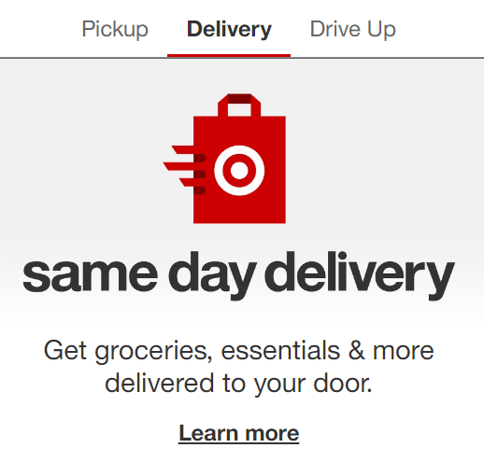
Different Solutions in the Market
Non-Mechanical Face Mask Dispensers
Online Shopping/ Delivery Services

Slide 3
Manual Mask Dispenser Pros & Cons
Pros
Can be mounted anywhere because of how light it is
Attachment process won’t require a lot of labor, tools, or equipment
Relatively cheap as it is just acrylic housing with masks inside
Does not require power
Reliable as it does not require complex 4-bar mechanisms or electronics
Cons
No limit on how many masks one can take
Contamination risk is higher
When someone takes a mask, there is a high chance of touching other masks, and spreading germs

Slide 4
Engineering Perspective Quantitative Comparison
Our prototype and the mentioned solution both utilize gravity to cycle masks downward and to provide users with masks
Mentioned solution depends on user’s strength and grip to pull the bottom mask from the stack whereas ours depends on the coefficient of friction between the plastic wrap & neoprene wheels
The mentioned solution does not draw power whereas our prototype draws about 2 Watts of power
The manufacturing of our product is more costly because of the added complexity required to house the dispensing mechanisms and to program, assemble and integrate the sensors into the product
Our manufacturing process may involve expensive molds & tools, especially if injected molded

Slide 5
Online Services Pros & Cons
Pros
More convenient to customers, which leads to more business
Sterile as customers don’t need to enter store
Safer for employees, as it eliminates direct person-to-person interaction
Ideal for customers with limited mobility
Cons
Overhead cost of creating/maintaining delivery service system
Requires dedicated host website, delivery drivers, and vehicles
Labor costs of drivers, delivery managers, and app programmers
Very limited service provided if used in healthcare services (telehealth)

Slide 6
Engineering Perspective Quantitative Comparison
People pay a higher price for the convenience of delivery
Requires splitting profit with multiple sources, ie. business with product, delivery service, & driver
Some costs can be reduced by up to 40% if relies on pre-existing inventory at a local store or business instead of a distribution center
Walmart has projected losses of over $1B thanks to delivery
The money that Uber makes doesn’t cover the cost of paying drivers, advertisement, cost of revenue, and operating costs

